Slide 1



Video Game Development
Mars Area Public Library – January 15, 2025
Jordan Baugher

Slide 2


Agenda
Brief introduction of the speaker
What is a video game?
Video game examples
Console vs. Computer Games vs. Mobile Games
Who plays video games?
Who can make video games?
Types of jobs in the video game industry
Video Game Assets
How do I get started?
Example game: Cookie Cruncher

Slide 3
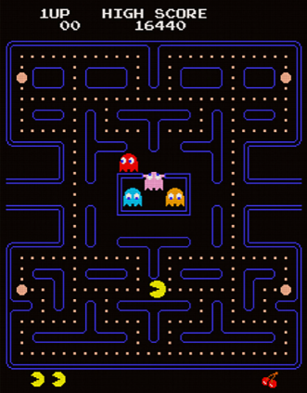
Jordan Baugher
Norah’s uncle
Software Architect
10 years of experience as a software developer
Experience with Blender and Unity 3D and Visual Studio

Slide 4
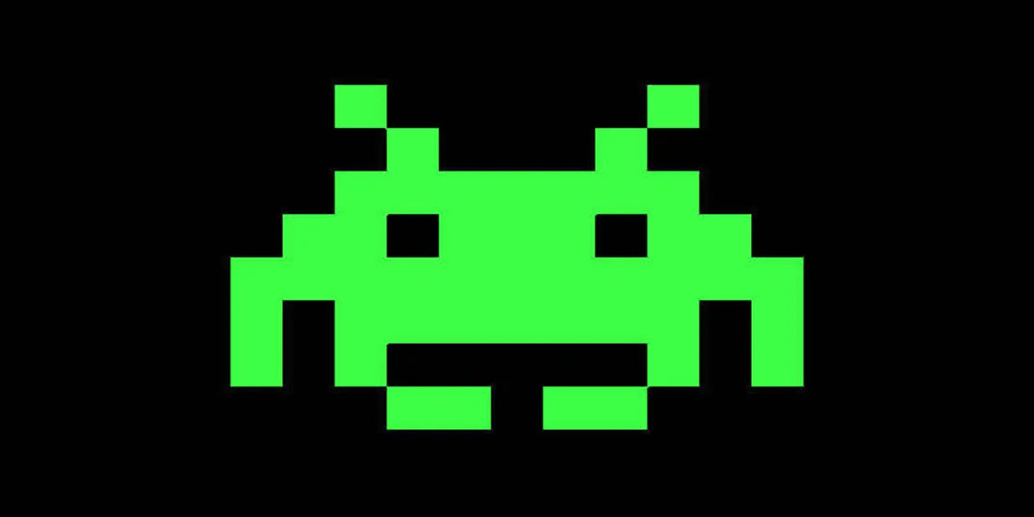
What is a video game?
“a game played by electronically manipulating images produced by a computer program on a television screen or other display screen”
tl;dr:
A game played on a screen with some kind of user inputs

Slide 5
Question
What are some examples of video games you’ve played?

Slide 6
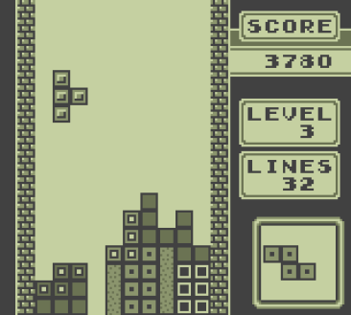
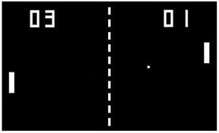
Early video games
Tetris, 1985
Pong, 1972

Slide 7
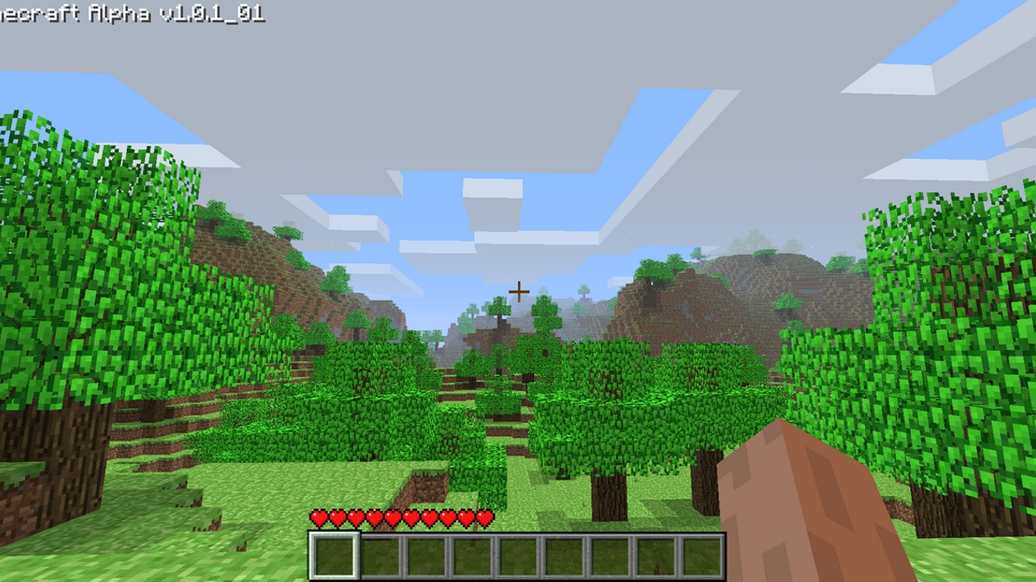
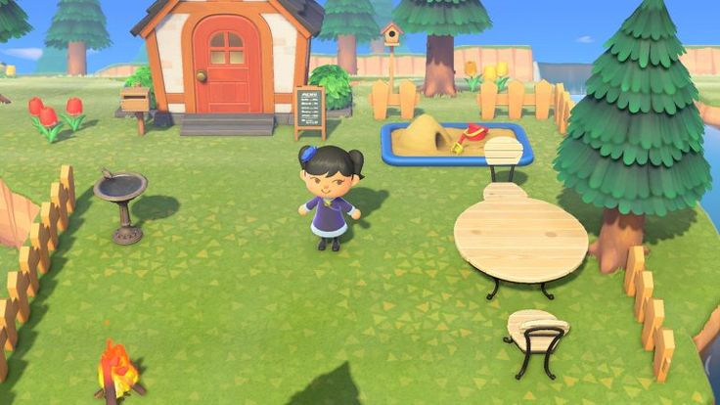
Modern video games
Minecraft, 2011
Animal Crossing New Horizons, 2020

Slide 8
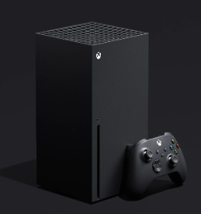
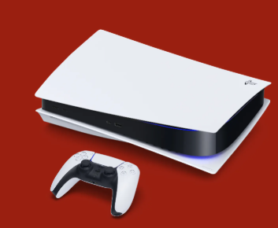
Video Game Devices
How can I play video games?
Tablets
Consoles (PS5, XBOX, Nintendo Switch)
Computers
Mobile Phones

Slide 9

Who plays video games?
61 percent of Americans ages 5-90 years old [source]
More than 40 percent of people around the world [source]

Slide 10
Who can make video games?
You can! ~40 percent of games on Steam are made by indie studios (including individual developers) [source]

Slide 11
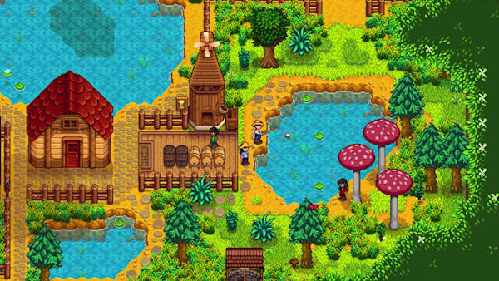

Examples of games made by one person
Minecraft
Stardew Valley
Flappy Bird
Tetris

Slide 12
But most big games are made by companies…
Video game jobs include:
Graphic Designers
Audio Engineers
Testers
Software Developers
Tech Support
Writers
Music Composers
Voice Actors
Animator
3D Modelers

Slide 13
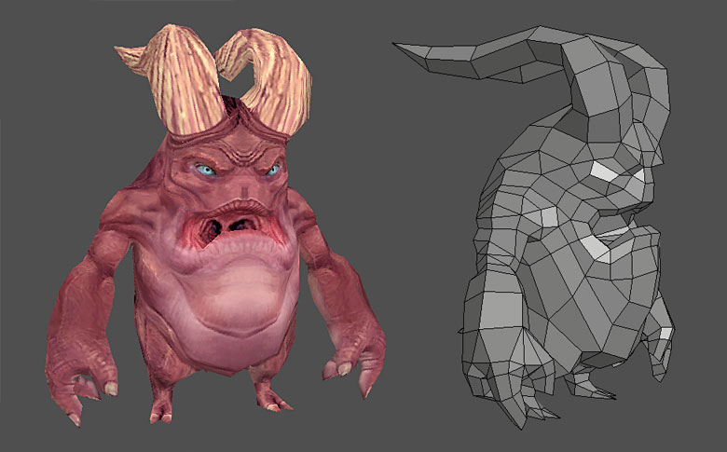
Video games are more than code…
Video game assets:
Music
3D Models
Sounds
Textures/Images
Animations

Slide 14
How can I get started?
Choose classes in school related to programming, robotics, math, art, music, or writing (or practice these on your own)
Start writing down or drawing out your ideas in a notebook or digitally
Start making very simple games with code or software

Slide 15

Example Game: Cookie Cruncher
Click on cookies to increase score before time runs out
Talk about what assets this game needed
Talk about the development process

Slide 16
Questions
Feel free to ask any questions you thought of
Or just share your thoughts about video games

